Slide 1

What Is a Language?
A language is a communication channel between two people — a structured system of words, symbols, or gestures used to exchange information and ideas.

Slide 2
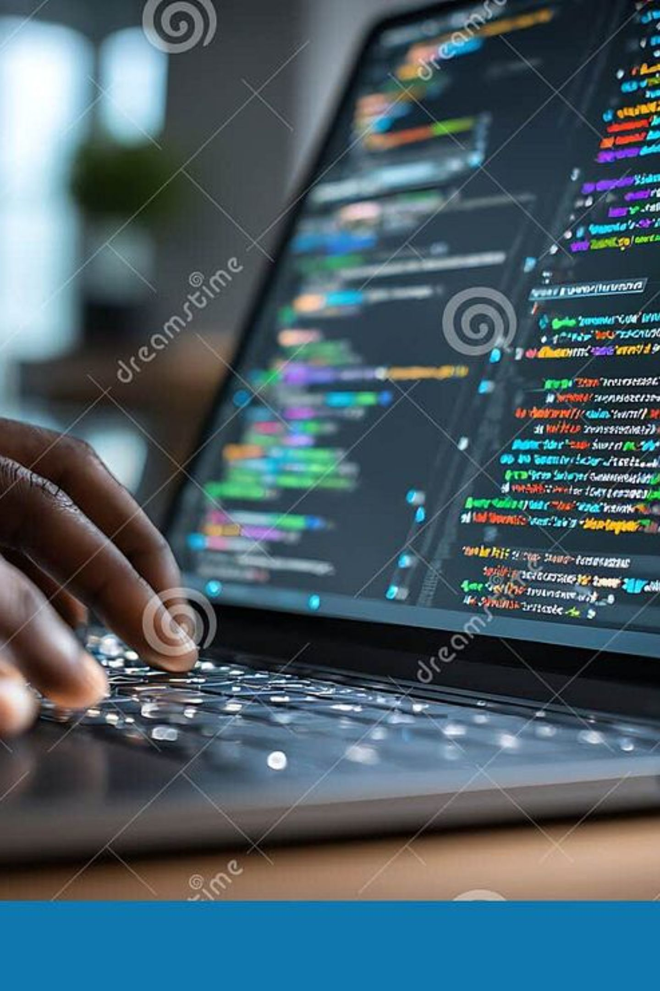
What Is a Programming Language?
A programming language is a formal language used to communicate instructions to a computer. Programmers write code that the computer can interpret and execute.
Syntax & Rules
Purpose-Built
Each language has its own grammar and structure that must be followed precisely.
Used to create software, apps, websites — from small scripts to large-scale systems.
Popular Examples
Python, Java, C++, JavaScript, Ruby, and many more.

Slide 3
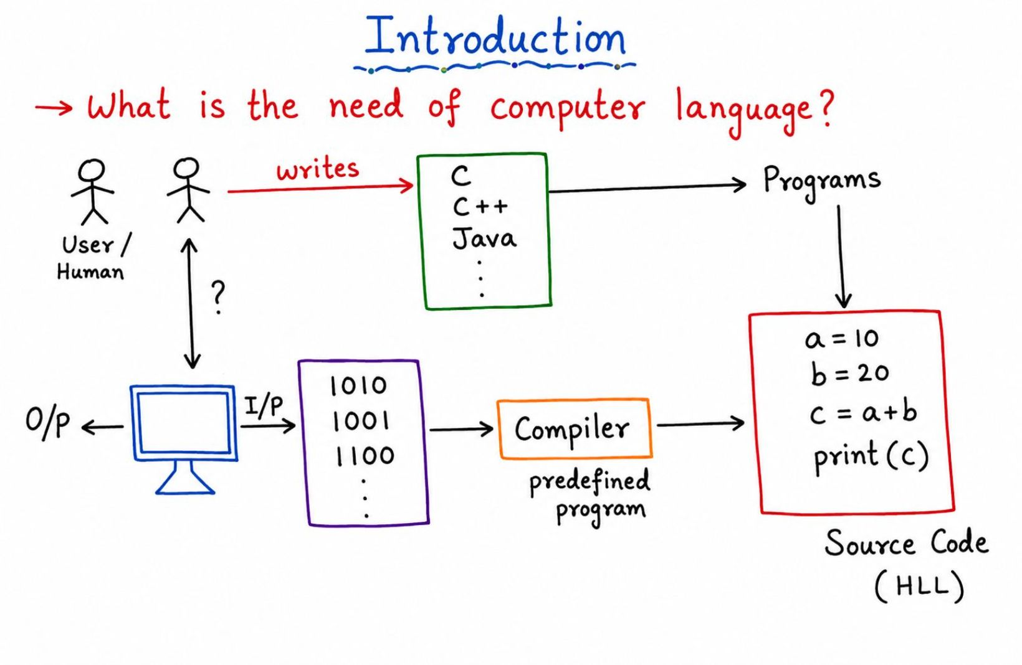
Computer Language: The Human–Machine Bridge
A computer language is a communication channel between a person and a system or device. It allows users to instruct machines in a structured, understandable way.
Without computer languages, we would have no way to tell a machine what to do — they are the foundation of all software.

Slide 4
Three Levels of Computer Languages
Computer languages exist at different levels of abstraction — from raw binary the machine understands directly, to human-readable English-like syntax.
High-Level Language
1
English-like instructions. Easy for humans, but computers cannot understand it directly.
Assembly-Level Language
2
Uses mnemonics like ADD and SUB. Machine-dependent but more readable than binary.
Machine-Level Language
3
Written in binary bits (0s and 1s). Directly executed by the CPU.

Slide 5
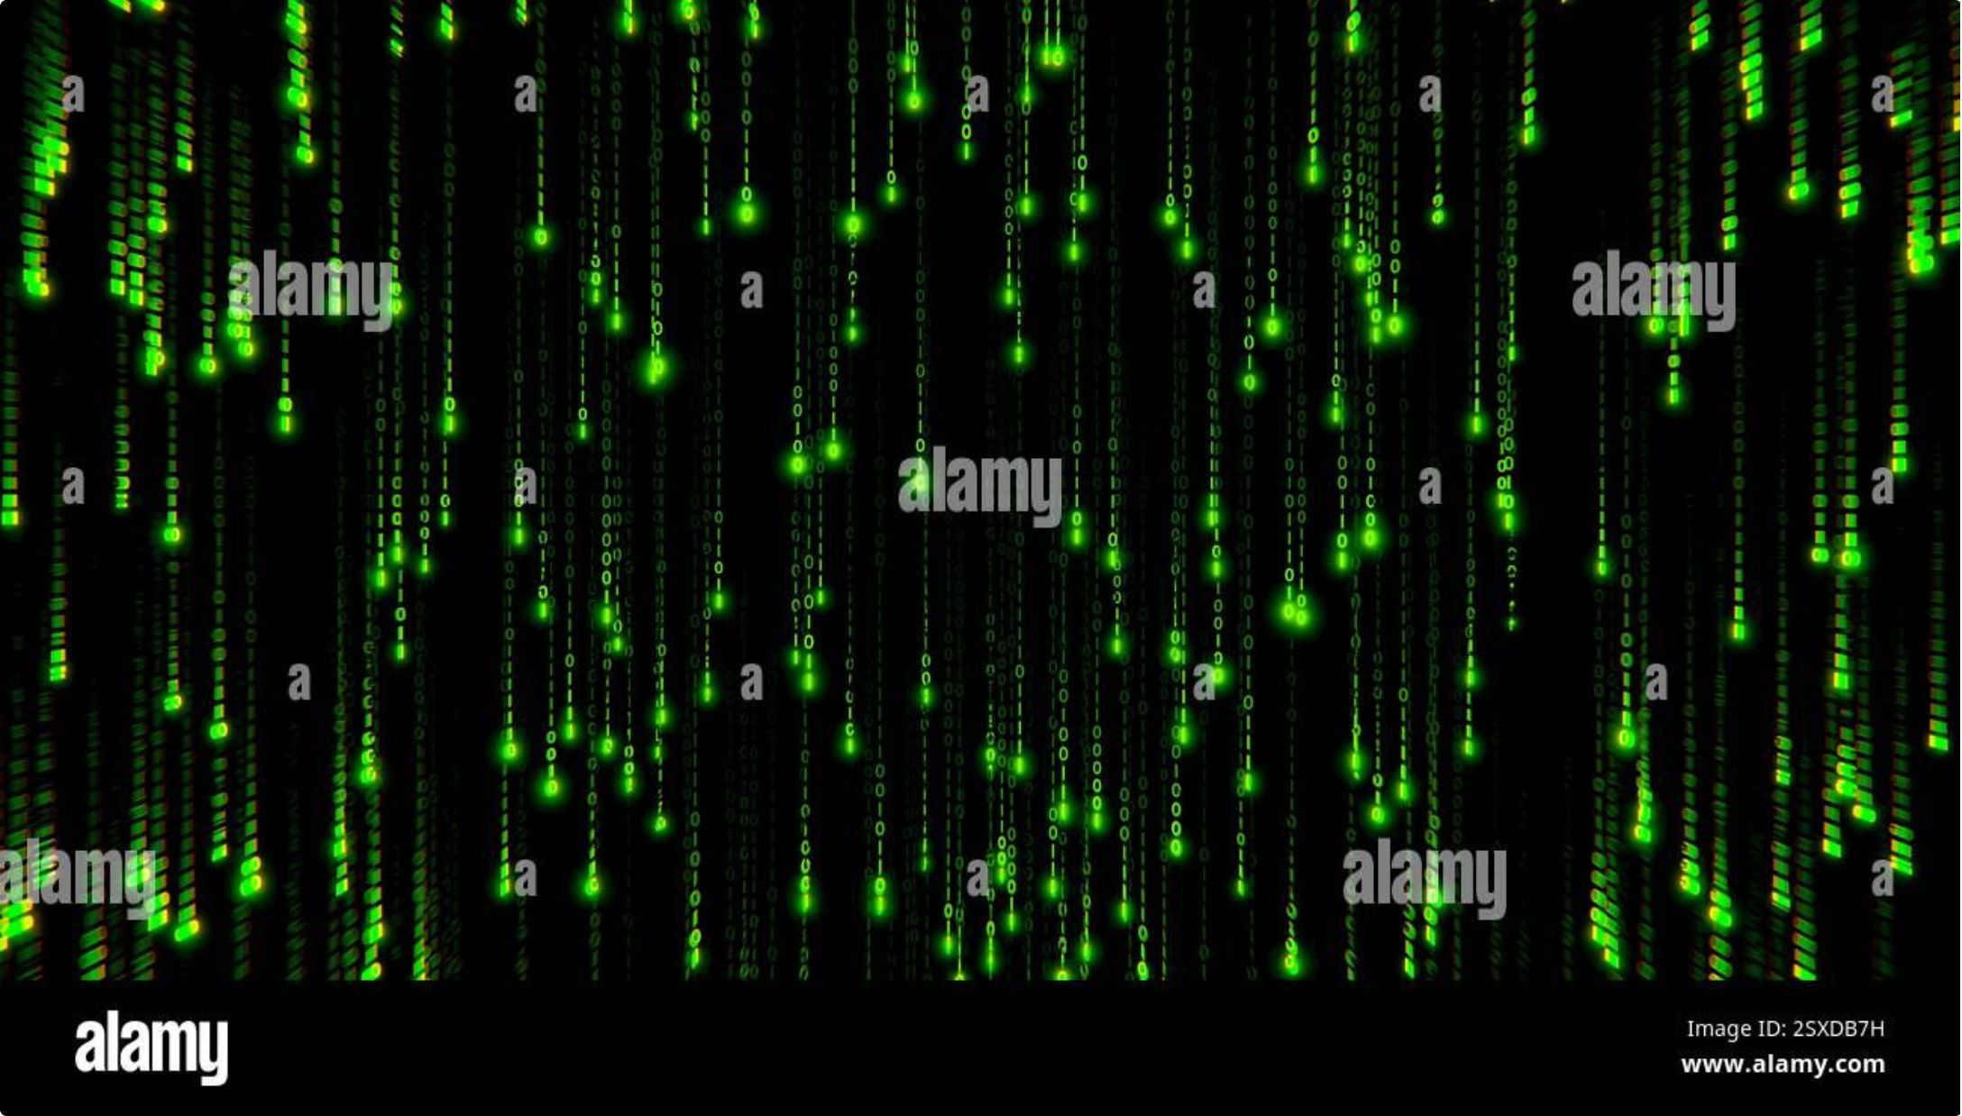
Machine-Level Language
Instructions are written entirely in binary digits — 0s and 1s. This is the only language the CPU directly understands.
Fastest execution — no translation needed
Extremely difficult for humans to read or write
Specific to each hardware architecture

Slide 6

Assembly & High-Level Languages
Assembly-Level Language
High-Level Language
Uses mnemonics — short symbolic codes — instead of binary. For example, ADD for addition and SUB for subtraction. Still machine-dependent, but far easier for humans to work with than raw binary.
Written using English-like words and mathematical notation. Examples include Python, Java, and C++. Computers cannot execute these directly — a translator is required to convert them into machine code.

Slide 7

Language Translators
Translators convert human-readable code into machine-executable instructions.
There are three main types:
Assembler:
Converts assembly-level programs into machine-level language. Works as system software tied to specific hardware.
Compiler
Translates an entire high-level program into machine code at once. Produces a standalone executable file.
Interpreter
Converts high-level code line by line, executing each statement immediately. Slower but easier to debug.

Slide 8
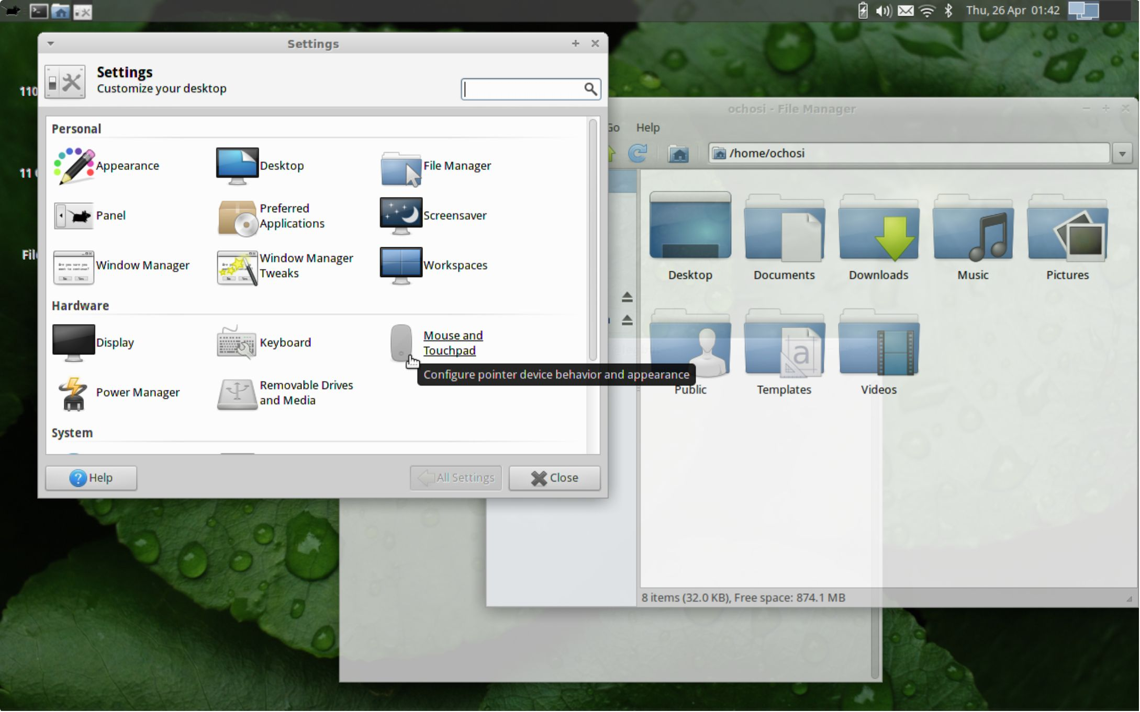
What Is an Interface?
An interface is a mediator between two entities — it defines how they communicate and interact.
The most common example is the Operating System (OS), which acts as the interface between the user and the hardware.
Interfaces hide complexity — users interact with simple controls while the system handles the technical details underneath.

Slide 9
Types of Computer Applications
🖥️ Standalone Applications
Must be installed on your system to work. Compatible with a single OS — Windows uses .exe, Mac uses .dmg, Linux uses .rpm.
Examples: MS Office, Google Chrome, Adobe Photoshop
🌐 Web Applications
Require no installation. Accessed through a browser over the internet. Work across any operating system.
Examples: Gmail, Facebook, Google Docs
Low Portability
Standalone apps require installation and are tied to one OS, while web apps run In any browser without setup.

